Slide 1
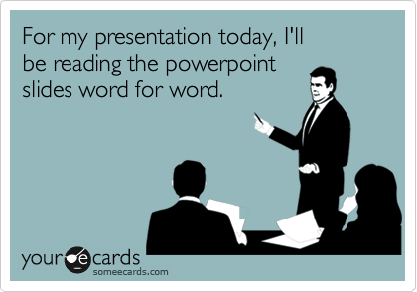

Slide 2
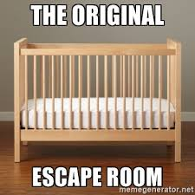
Today we are proud to present you :

Slide 3
Product
Our amazing escape room has 3 features
Dynamic sounds (yes, they are dynamic, don’t argue :)
Text to speech
Picture opening and CLOSING (welcome to the world where everything is complicated)

Slide 4
Tech
Sound libraries
Mixer
Time
Picture libraries
Pillow
Psutil : used to kill the program opening the picture
Text to speech libraries
gTTS
Mixer
Time
BytesIo (from IO) : in order to play the speech from buffer

Slide 5
